Slide 1


SkillBridge – Career Skill Tracker

Slide 2

CONTENTS
1. Introduction
2. Real-World Problem
3. Application Architecture
4. Key Features
6. Technology Stack
5. Real-World Impact
7. Why SkillBridge Stands Out
8. Future Scope
9. Conclusion

Slide 3


Introduction
1
SkillBridge is a console-based Java application developed to address a pressing issue among rural youth and students:
2
Despite holding degrees, many remain unemployed due to:
• Skill gaps
• The lack of a clear, guided pathway to develop skills aligned with their career aspirations.
• Unclear learning paths
• Poor internet access

Slide 4

Real-World Problem
Rural youth and students struggle with:
• Absence of job-ready skills despite academic qualifications
• No structured roadmap to reach dream careers
• Job portals only show listings, not missing skills
• Motivation drops due to lack of progress tracking
• Poor internet makes continuous learning difficult

Slide 5

Application Architecture
Built using modular OOP principles in Java.
Modules:
• UserAuth – Signup, Login, Forgot Password
• SkillGapModule – Finds skill gaps and provides links
• QuizModule – Career-specific quizzes
• MotivationModule – Random motivational quotes
• ActivityTracker – Monitors progress
• PDFModule – Exports learning plans as PDFs

Slide 6



Key Features
1
2
3
4
5
User Signup & Login
IT / Non-IT Job Track Selection
Skill Gap Analysis with Reference Links
Personalized Progress Tracker
Motivational Tip Generator
6
7
Sector-specific Quiz Module
PDF Export for Offline Learning

Slide 7

Real-World Impact
SkillBridge benefits rural youth and students by:
• Giving clear learning direction
• Promoting self-learning and independence
• Enabling offline access via PDF exports
• Keeping users engaged through gamification
• Building job readiness through skills

Slide 8

Technology Stack
1
Language
2
Storage
Java (console-based)
File I/O (for users, progress, and skills)
3
PDF Generation
4
Design Pattern
Java PDF libraries (like iText or Apache PDFBox)
Modular Object-Oriented Programming

Slide 9





Why SkillBridge Stands Out
Focuses on real social impact
Modular design: Ideal for NGOs, training centers, and colleges
Offline-first approach helps overcome internet barriers
Can be expanded to web and mobile apps in the future
Helps users learn first, then apply for jobs

Slide 10
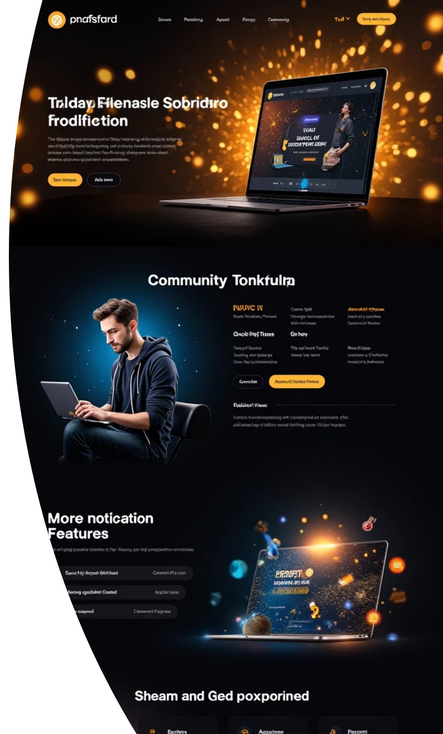
Future Scope
Planned enhancements include:
• Web and Mobile App Versions
• AI-based Skill Recommendations
• Peer Learning Community Forums
• LinkedIn Integration for Job Notifications
• Multi-language support for better accessibility

Slide 11

Conclusion
SkillBridge empowers every learner by providing a guided, motivational, and personalized learning journey. It bridges the skills gap and prepares individuals for the future, even in low-internet rural areas.
"Empowering every learner to succeed."

Slide 12

Thank You

